Slide 1
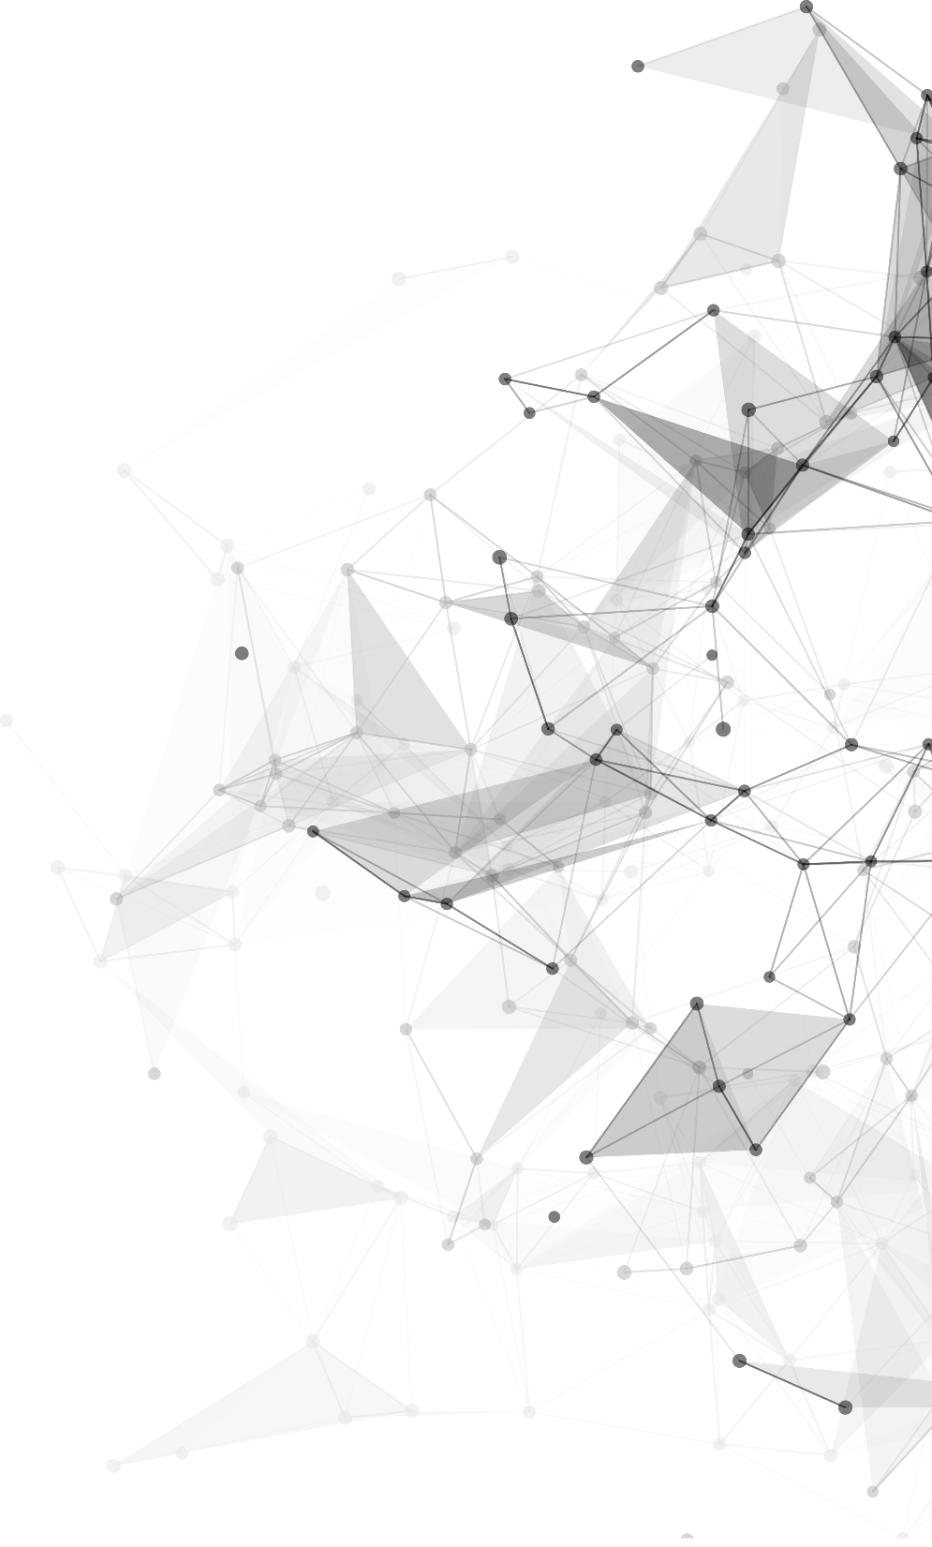

nanoBench: A Low-Overhead Tool for Running
Microbenchmarks on x86 Systems
浙江大学Arclab实验室周会 6.10

Slide 2
目录
Part 01 Microbenchmark
Part 02 缓存替换策略

Slide 3
PART 01
Microbenchmark
Notes:
Okey， let’s begin with the introduction.

Slide 4
Benchmark
Benchmark：在计算机领域一般译作基准测试，表示成体系的或一整套的测试基准，有时也用于指代实施某一基准测试的软件程序。需要注意的是，基准测试的用户希望基准测试套件是完整的、准确的和一致的，并且基准测试注重测试结果的可比性与可复现性，其测试分数可以作为性能的相对度量。^{[1]}
Benchmark通常是由权威组织提出并管理，经过相当长的一段时间不断优化、改进，才能使其测试结果具有越来越强的可比性，测试过程具有可复现性。
事务处理性能测试委员会（TPC）
目的：制定数据库相关软件benchmark并监督其执行。
雏形：20世纪80年代提出的OLTP事务处理模式。
发展：从OLTP开始，经过十几年之后，ITOM牵头成立了TPC。在随后的几十年里，TPC为了规范市场，迎合服务器发展需求，支持大数据测试等，先后提出了TPC-A、TPC-C、TPC-H、TPC-E等多个测试标准，随着benchmark的不断发展，也废除了诸如TCP-B、TCP-D等多个标准。
[1] Poovey J A, Conte T M, Levy M, et al. A benchmark characterization of the EEMBC benchmark suite[J]. IEEE micro, 2009, 29(5): 18-29.
Notes:
Being an undergraduate and to be an excellent graduate in computer science and technology, I think I have and should have the following qualities. The first one is solid theoretical foundation and good study ability, these can be shown via my transcript. Secondly, I have great scientific spirts. Pragmatic and innovation as the motto of Zhejiang University are deeply engraved in my heart. Done so many Courses’ projects make me work better with other people. Concentration
And self-discipline make me go farther on the road of scientific research. Last but not the least, the comprehensive quality of mine will be shown in my personal statement.

Slide 5
研究现状
研究benchmark本身
对某一类计算机工具进行性能测试：TPC测试集、Iozone测试集等。
对计算机硬件进行性能测试：LINPACK测试、3DMark、Lmbench、CashSeq等。
对程序段或者某一条指令进行性能测试（微基准测试，microbenchmark）：nanoBench、asmbench等。
研究benchmark衍生问题
对硬件设计本身的改进：电源80plus标准引导的变革中，S.-A. Liang等人分别设计了符合铜牌要求的高功率高效率PC端电源技术^{[1]}，符合金牌要求的高功率多输出AC-DC电源^{[2]}，以及符合白金牌要求的高功率多输出AC-DC电源^{[3]}。
对benchmark算法本身的改进：Chen Y等人^{[4]}提出了Bhive框架，并使用该框架对IACA、llvm-mca、Ithemal、OSACA四个现有benchmark本身做了分析。
对benchmark测试相关算法的改进：nanoBench团队提出了缓存替换策略的命名方式，开发了工具CacheAnalyzer用来分析缓存替换策略。
[1] Liang S A. A high power and high efficiency PC power supply topology with low cost design to meet 80 Plus Bronze requirements[C]
[2] Liang S A, Huang C W, Lu P C. A high power and multi-outputs of AC-DC power supply design to meet 80 plus gold and ErP requirements[C]
[3] Lu P C, Liang S A, Huang C W. A high power and multi-outputs of AC-DC power supply design to meet 80 plus platinum and ErP requirements[C]
[4] Chen Y, Brahmakshatriya A, Mendis C, et al. BHive: A benchmark suite and measurement framework for validating x86-64 basic block performance models[C]
[5] Abel A, Reineke J. nanoBench: a low-overhead tool for running microbenchmarks on x86 systems[C]
Notes:
Being an undergraduate and to be an excellent graduate in computer science and technology, I think I have and should have the following qualities. The first one is solid theoretical foundation and good study ability, these can be shown via my transcript. Secondly, I have great scientific spirts. Pragmatic and innovation as the motto of Zhejiang University are deeply engraved in my heart. Done so many Courses’ projects make me work better with other people. Concentration
And self-discipline make me go farther on the road of scientific research. Last but not the least, the comprehensive quality of mine will be shown in my personal statement.

Slide 6
团队工作
nanoBench，一个microbenchmark测试工具
支持Brodwell、Haswell、IceLake、Ivybridge、KnightsLanding、Nehalem、SandyBridge、Skylake、XeonScalable、Zen等十多个系列CPU架构。
在各个平台上测试了x86_64指令集的超过130,000条指令及其变种。
自动生成microbenchmark测试汇编码。
使用性能监视器（PFC）来读取数据，通过统计学与代码优化尽可能消除误差。
nanoBench团队还开发了包含CacheAnlyzer、cpuBench、CPUID在内的多个辅助工具。
Notes:
Being an undergraduate and to be an excellent graduate in computer science and technology, I think I have and should have the following qualities. The first one is solid theoretical foundation and good study ability, these can be shown via my transcript. Secondly, I have great scientific spirts. Pragmatic and innovation as the motto of Zhejiang University are deeply engraved in my heart. Done so many Courses’ projects make me work better with other people. Concentration
And self-discipline make me go farther on the road of scientific research. Last but not the least, the comprehensive quality of mine will be shown in my personal statement.

Slide 7
PFC
每一个核心都有一个自己的性能监控单元，该单元会配备很多的事件计数器。
固定功能性计数器（Fixed-Function Performance Counters，FPFC）：最近的Intel CPU拥有三个可以被RDPMC指令读取的固定功能性计数器。他们会对已经执行过的指令数，核心的周期数，引用循环（reference cycle）的数目进行计数。
另外，在最近的Intel CPU和AMD 第17代CPU上，还有两个可用的固定功能性计数器：用来计数核心时钟周期的APERF计数器和用来计算引用循环数的MRERF计数器。这两个计数器只能被RDMSR指令访问，所以也只能在内核空间中使用。
2）可编程计数器（Programable Performance Counters，FPFC） ：最近发布的Intel CPU通常有2-8个可编程计数器，而AMD 17代CPU有6个。它们可以被编程为大量不同的性能计数事件(在某些cpu上超过200个)计数，例如使用特定端口的微指令（μops）的数量，内存层次结构中不同级别的高速缓存缺失（cache miss）的数量，错误预测的分支的数目等。这些计数器都可以通过RDPMC指令访问。
Notes:
Being an undergraduate and to be an excellent graduate in computer science and technology, I think I have and should have the following qualities. The first one is solid theoretical foundation and good study ability, these can be shown via my transcript. Secondly, I have great scientific spirts. Pragmatic and innovation as the motto of Zhejiang University are deeply engraved in my heart. Done so many Courses’ projects make me work better with other people. Concentration
And self-discipline make me go farther on the road of scientific research. Last but not the least, the comprehensive quality of mine will be shown in my personal statement.

Slide 8
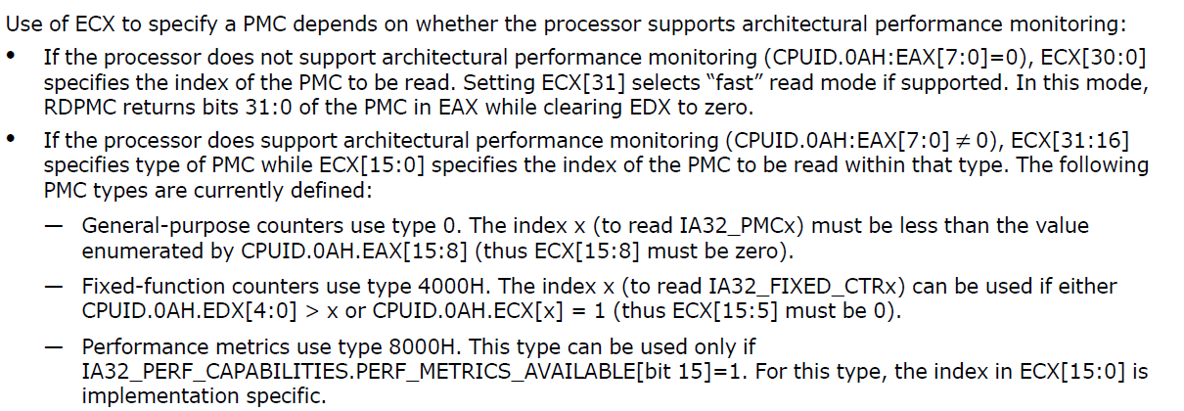
PFC
Notes:
Being an undergraduate and to be an excellent graduate in computer science and technology, I think I have and should have the following qualities. The first one is solid theoretical foundation and good study ability, these can be shown via my transcript. Secondly, I have great scientific spirts. Pragmatic and innovation as the motto of Zhejiang University are deeply engraved in my heart. Done so many Courses’ projects make me work better with other people. Concentration
And self-discipline make me go farther on the road of scientific research. Last but not the least, the comprehensive quality of mine will be shown in my personal statement.

Slide 9
PFC
AArch64中，OS有多个运行状态，其中用户态运行在EL0下。
在ARMv8中，有Performance Monitors Control Register系列寄存器，其中PMCCNTR_EL0就类似于x86的TSC寄存器。但在ARM中，默认情况是用户态是不可以读的，需要在内核态使能后，用户态才能读取。
开关在由寄存器MCR_EL0控制。实际上这个寄存器控制整个PMU寄存器在用户态是否可读写，不仅仅是PMCCNTR_EL0。
x86下TSC的值，在CPU上电后就开始累加，且是只读寄存器。但在ARM中，只有使能PMCCNTR_EL0后，TSC才开始累加计数，且PMCCNTR_EL0寄存器可清零，相当于计时器。
Notes:
Being an undergraduate and to be an excellent graduate in computer science and technology, I think I have and should have the following qualities. The first one is solid theoretical foundation and good study ability, these can be shown via my transcript. Secondly, I have great scientific spirts. Pragmatic and innovation as the motto of Zhejiang University are deeply engraved in my heart. Done so many Courses’ projects make me work better with other people. Concentration
And self-discipline make me go farther on the road of scientific research. Last but not the least, the comprehensive quality of mine will be shown in my personal statement.

Slide 10
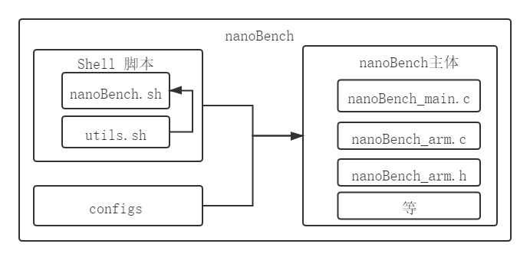
nanoBench 设计
读取命令，解析参数，编码待测试指令
解析剩余的参数，
生成microbenchmark测试汇编指令，
进行测试并输出结果
用于配置可编程性能计数器（PPFC）
nanoBench设计框架
Notes:
Being an undergraduate and to be an excellent graduate in computer science and technology, I think I have and should have the following qualities. The first one is solid theoretical foundation and good study ability, these can be shown via my transcript. Secondly, I have great scientific spirts. Pragmatic and innovation as the motto of Zhejiang University are deeply engraved in my heart. Done so many Courses’ projects make me work better with other people. Concentration
And self-discipline make me go farther on the road of scientific research. Last but not the least, the comprehensive quality of mine will be shown in my personal statement.

Slide 11
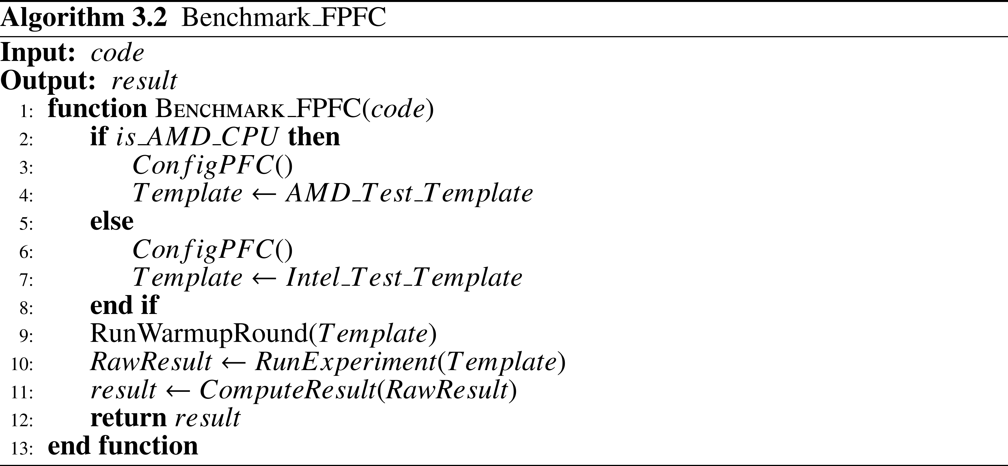
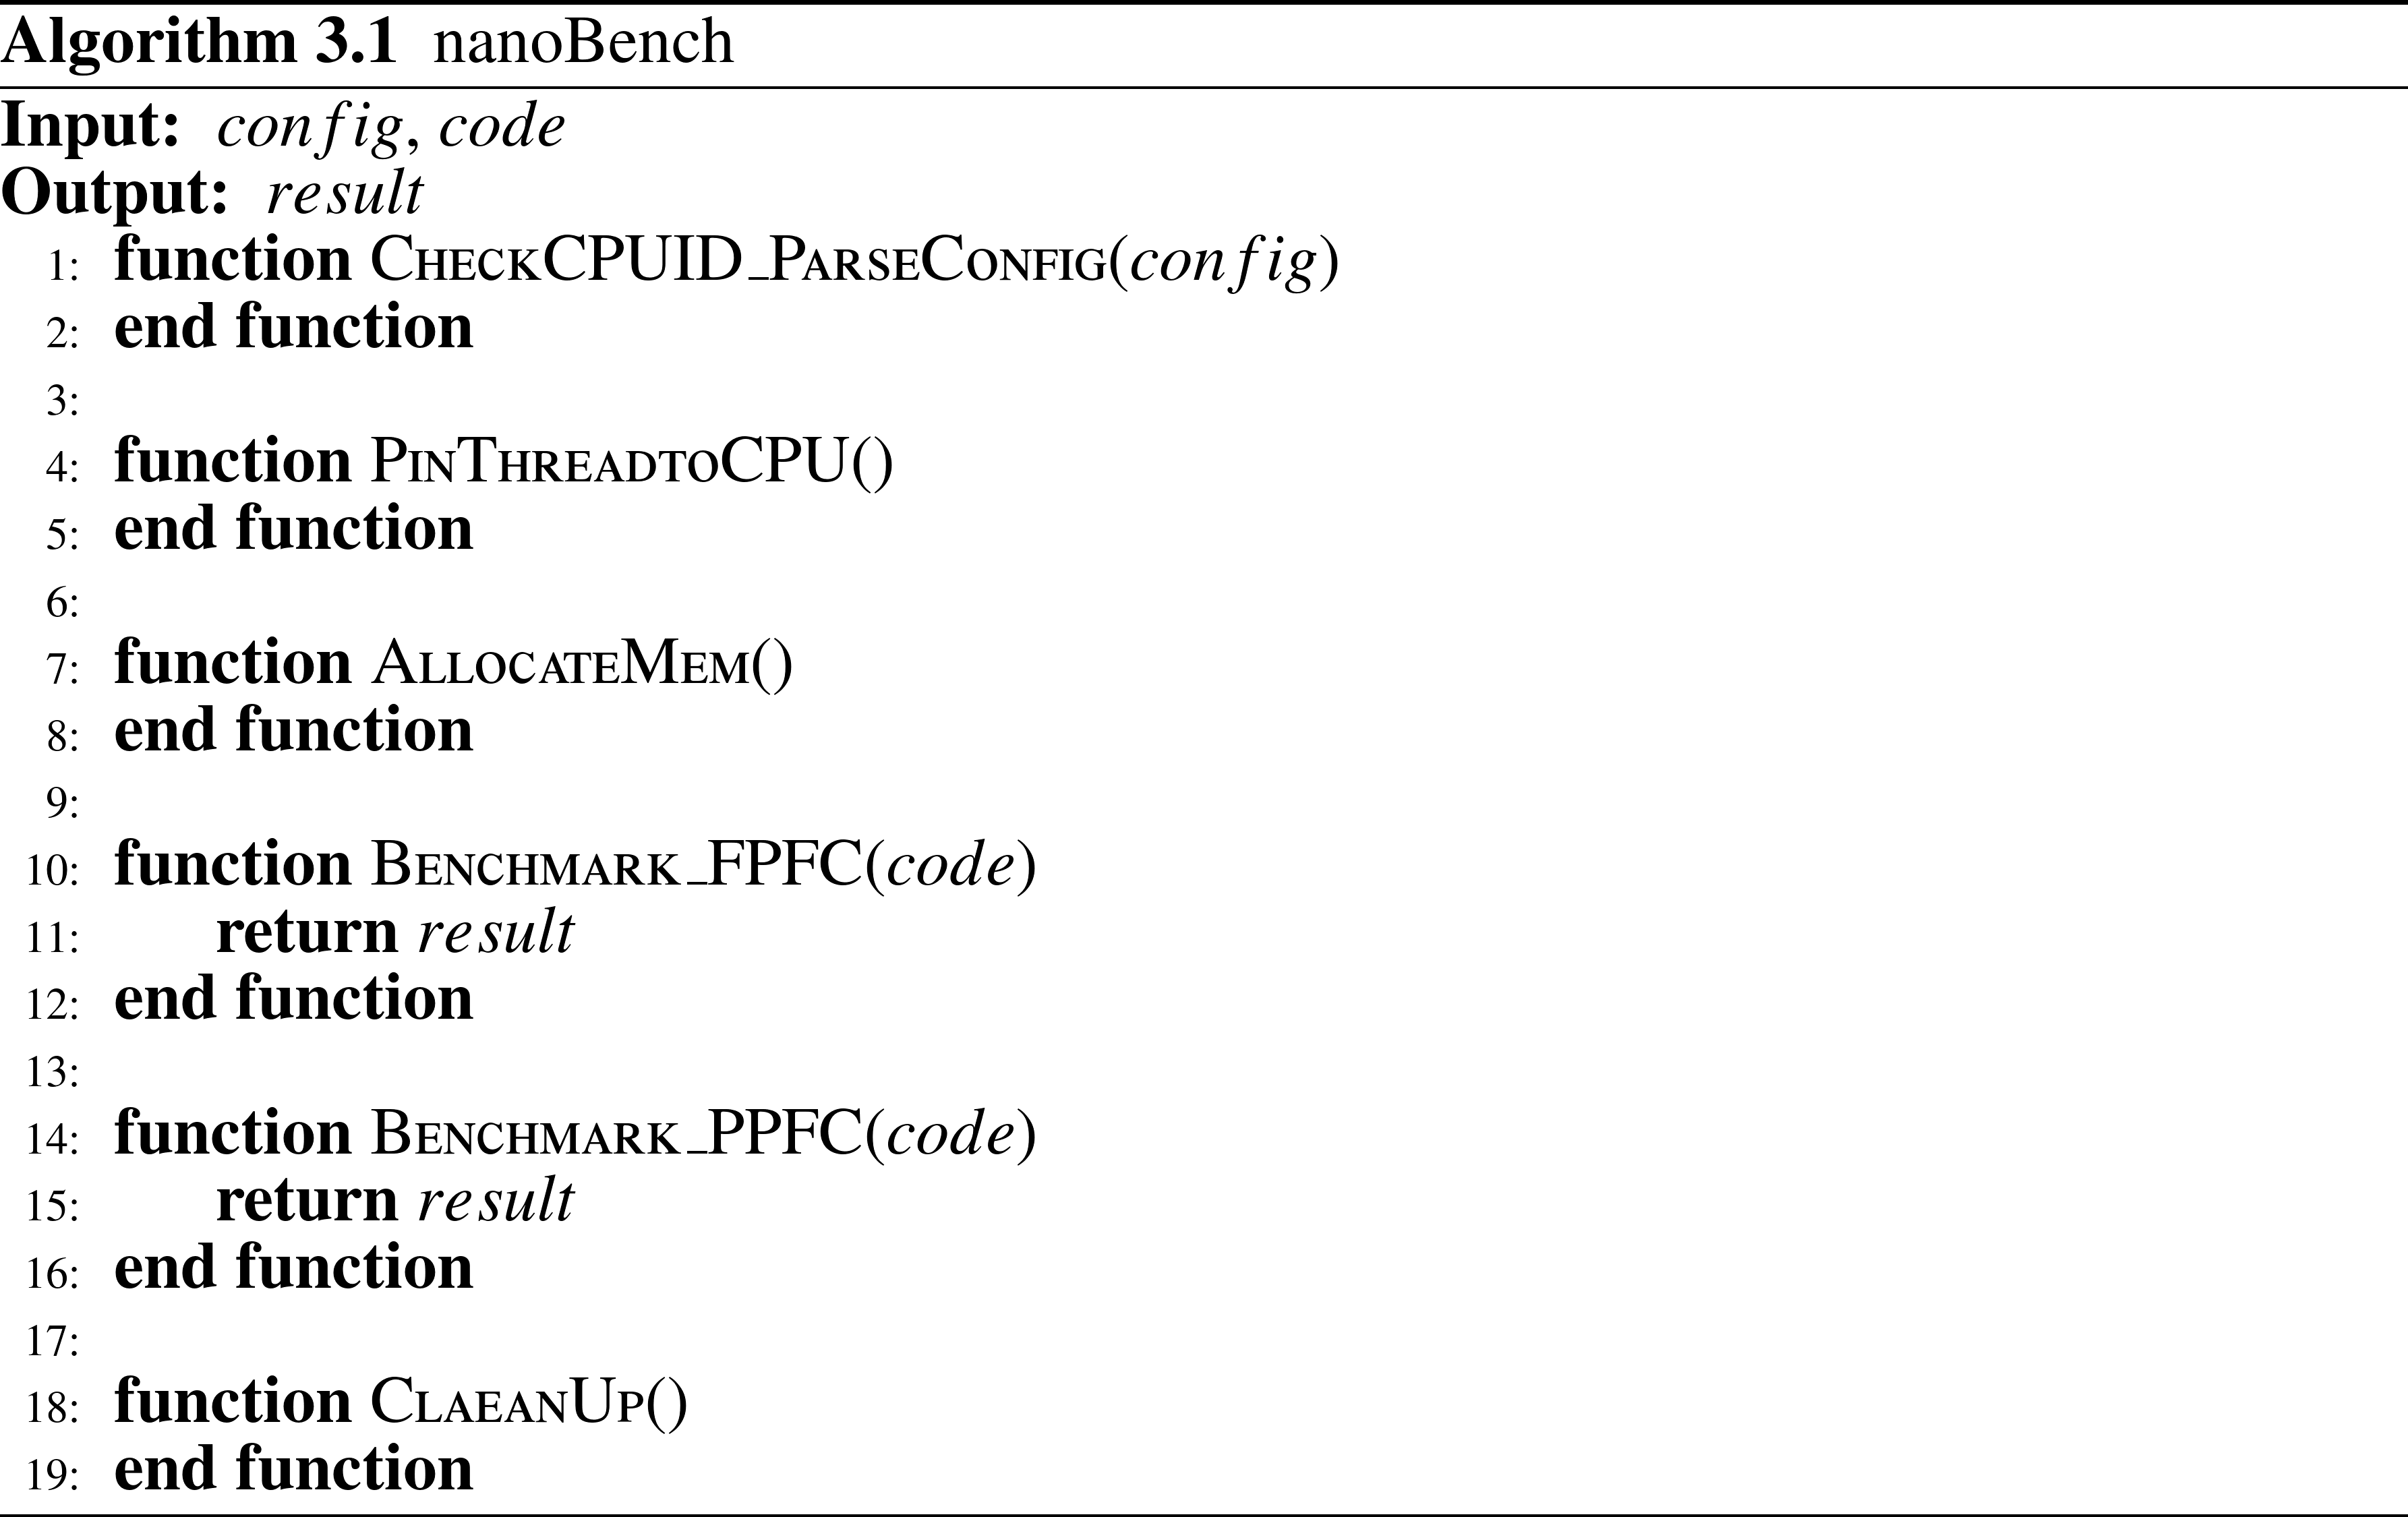
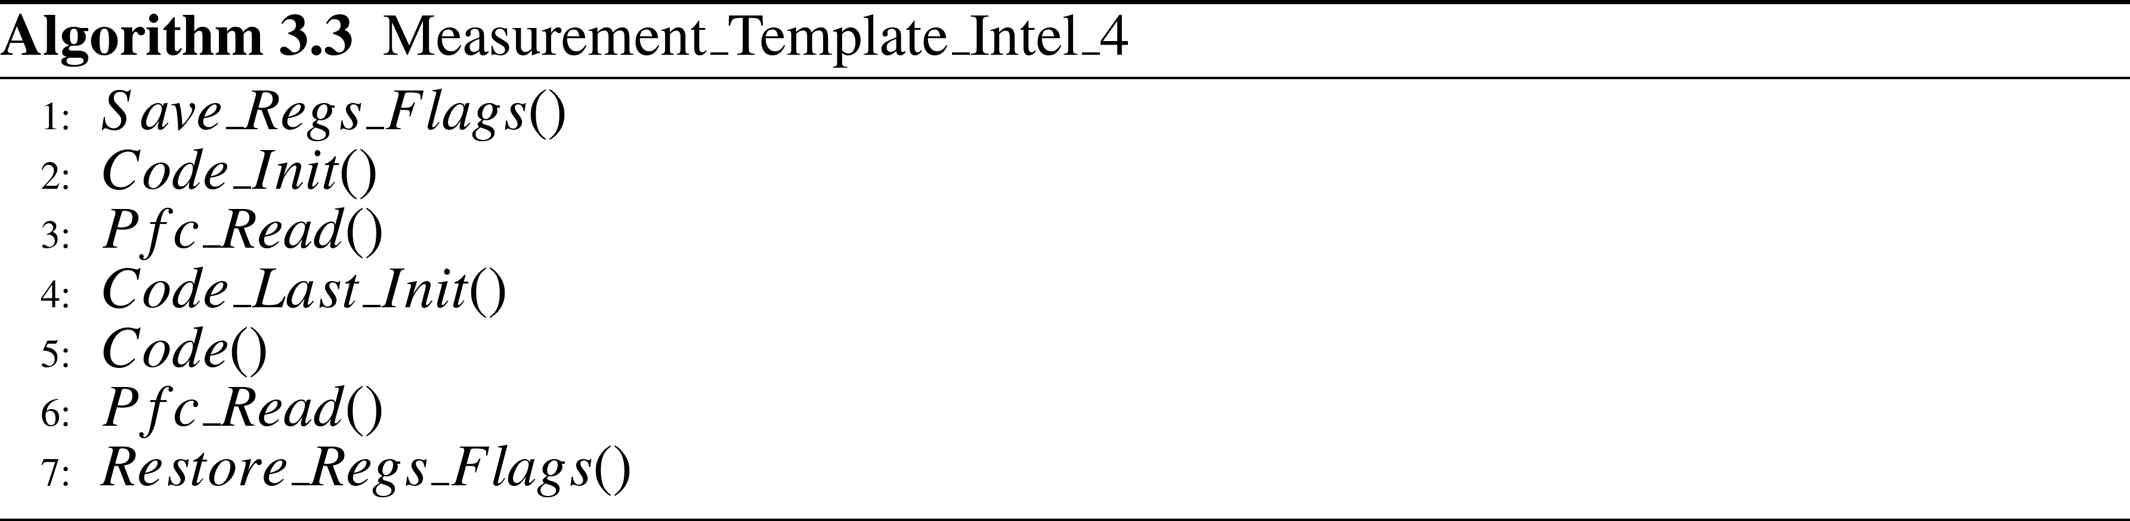
nanoBench 算法
Benchmark_FPFC算法
解析参数
设置程序线程CPU亲和力
分配内存空间
FPFC参数测试
PPFC参数测试
清除
nanoBench整体算法流程
Measurement_Template_Intel_4
Notes:
Being an undergraduate and to be an excellent graduate in computer science and technology, I think I have and should have the following qualities. The first one is solid theoretical foundation and good study ability, these can be shown via my transcript. Secondly, I have great scientific spirts. Pragmatic and innovation as the motto of Zhejiang University are deeply engraved in my heart. Done so many Courses’ projects make me work better with other people. Concentration
And self-discipline make me go farther on the road of scientific research. Last but not the least, the comprehensive quality of mine will be shown in my personal statement.

Slide 12
nanoBench 算法
误差消除
消除统计误差：提供取最大、最小、算术平均、2-8平均等多种方案；一次测试运行多次待测试指令（组）unroll循环等。
消除系统误差：运行两次测试，分别为主循环和基础循环，利用两者有待测试指令（组）循环次数差异，相减去除测试指令的开销；直接将测试结果以汇编码形式写入结果变量所在内存；序列化指令读写防止乱序执行带来的不精确等。
Notes:
Being an undergraduate and to be an excellent graduate in computer science and technology, I think I have and should have the following qualities. The first one is solid theoretical foundation and good study ability, these can be shown via my transcript. Secondly, I have great scientific spirts. Pragmatic and innovation as the motto of Zhejiang University are deeply engraved in my heart. Done so many Courses’ projects make me work better with other people. Concentration
And self-discipline make me go farther on the road of scientific research. Last but not the least, the comprehensive quality of mine will be shown in my personal statement.

Slide 13
PART 02
缓存替换策略

Slide 14
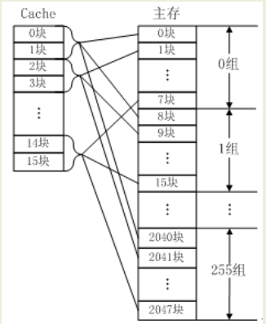
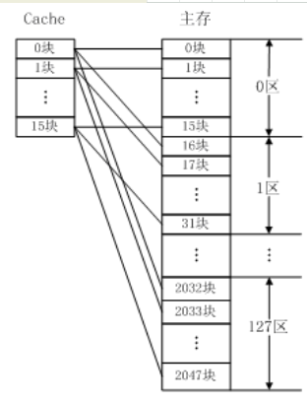
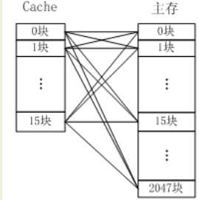
缓存替换策略
全相连映射
组相连映射
直接映射
主存中任何一块都可以映射到Cache中的任何一块位置上
主存和Cache都分组，主存中一个组内的块数与Cache中的分组数相同，组间采用直接映射，组内采用全相联映射
主存中的一个块只能映射到
Cache的某一特定块中去
Notes:
Being an undergraduate and to be an excellent graduate in computer science and technology, I think I have and should have the following qualities. The first one is solid theoretical foundation and good study ability, these can be shown via my transcript. Secondly, I have great scientific spirts. Pragmatic and innovation as the motto of Zhejiang University are deeply engraved in my heart. Done so many Courses’ projects make me work better with other people. Concentration
And self-discipline make me go farther on the road of scientific research. Last but not the least, the comprehensive quality of mine will be shown in my personal statement.

Slide 15
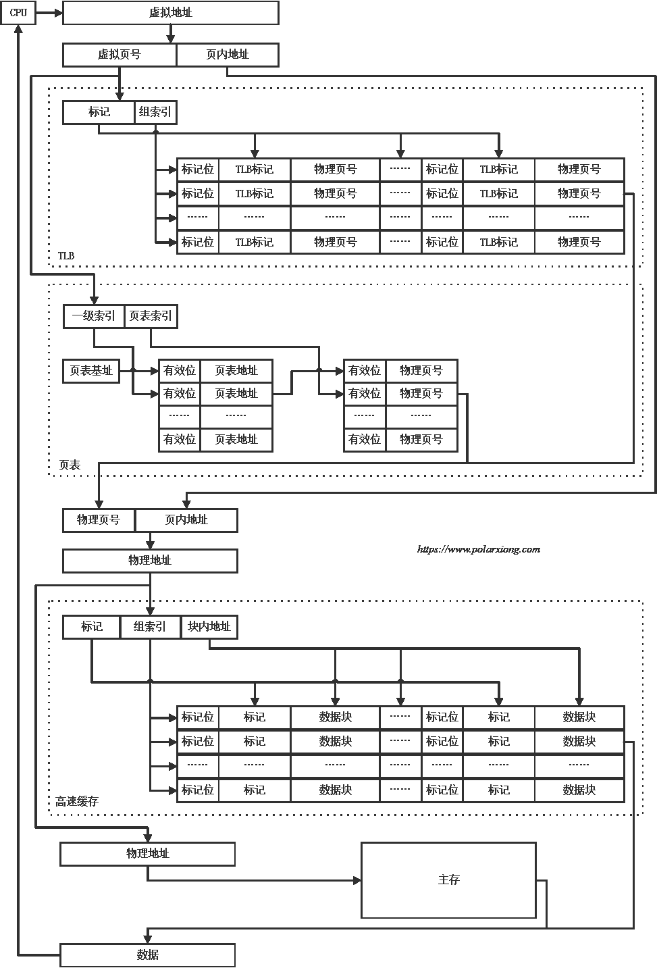

缓存替换策略
Notes:
Being an undergraduate and to be an excellent graduate in computer science and technology, I think I have and should have the following qualities. The first one is solid theoretical foundation and good study ability, these can be shown via my transcript. Secondly, I have great scientific spirts. Pragmatic and innovation as the motto of Zhejiang University are deeply engraved in my heart. Done so many Courses’ projects make me work better with other people. Concentration
And self-discipline make me go farther on the road of scientific research. Last but not the least, the comprehensive quality of mine will be shown in my personal statement.

Slide 16

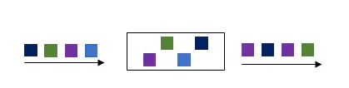
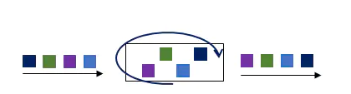
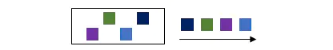
缓存替换策略
FIFO: First in First out
Random
Round Robin
LRU（Least Recently Used）
Notes:
Being an undergraduate and to be an excellent graduate in computer science and technology, I think I have and should have the following qualities. The first one is solid theoretical foundation and good study ability, these can be shown via my transcript. Secondly, I have great scientific spirts. Pragmatic and innovation as the motto of Zhejiang University are deeply engraved in my heart. Done so many Courses’ projects make me work better with other people. Concentration
And self-discipline make me go farther on the road of scientific research. Last but not the least, the comprehensive quality of mine will be shown in my personal statement.

Slide 17
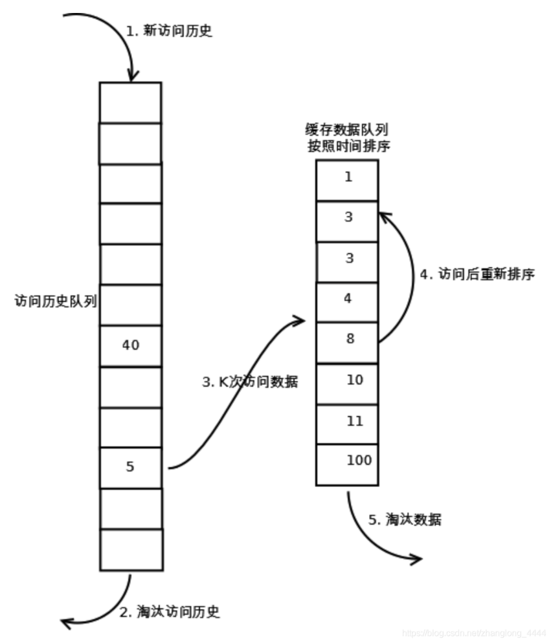
缓存替换策略
MRU（Most Recently Used）按使用频率排序
考虑最近的使用频率和最后被访问的时间→LRFU
LRFU采用队列分级思想
LRU-K
LRU-K需要多维护一个队列，用于记录所有缓存数据被访问的历史。只有当数据的访问次数达到K次的时候，才将数据放入缓存
热链
1 2 3 4
冷链
使用次数：低 ------------------------高
热链
1 2 3 4
冷链
使用次数：低 ------------------------高
Notes:
Being an undergraduate and to be an excellent graduate in computer science and technology, I think I have and should have the following qualities. The first one is solid theoretical foundation and good study ability, these can be shown via my transcript. Secondly, I have great scientific spirts. Pragmatic and innovation as the motto of Zhejiang University are deeply engraved in my heart. Done so many Courses’ projects make me work better with other people. Concentration
And self-discipline make me go farther on the road of scientific research. Last but not the least, the comprehensive quality of mine will be shown in my personal statement.

Slide 18
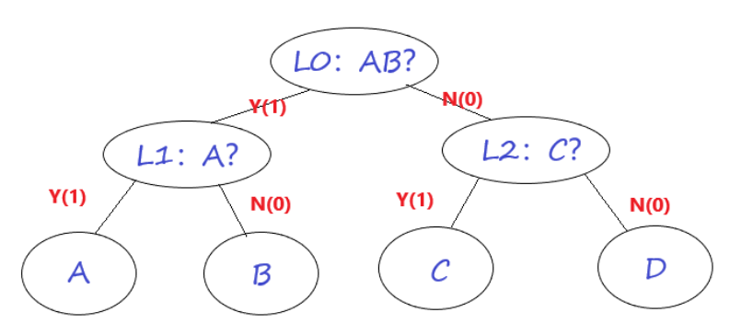
缓存替换策略
Pseudo LRU
一个set中有n行的缓存（n-ways）它们最近访问的时间有n!种组合。对每一个set我们需要O(log n!)=O(nlogn)位记录。
只需要logn – 1位来记录
如果最近访问的是R0或R1，则L0位置1；否则（最近访问的是R2或者R3）， 则L0位置0.
在R0，R1之间，若最近访问的是R0，则L1置1； 否则，L1置0.
在R2和R3之间，若最近访问的是R2，则L2置1；否则，L2置0。
以上建立的L0,L1,L2三位标记，可使我们按如下规则替换有效:
若 L0=0 且 L1=0, replace R0；
若 L0=0 且 L1=1, replace R1；
若 L0=1 且 L2=0, replace R2；
若 L0=1 且 L2=0, replace R3；
Notes:
Being an undergraduate and to be an excellent graduate in computer science and technology, I think I have and should have the following qualities. The first one is solid theoretical foundation and good study ability, these can be shown via my transcript. Secondly, I have great scientific spirts. Pragmatic and innovation as the motto of Zhejiang University are deeply engraved in my heart. Done so many Courses’ projects make me work better with other people. Concentration
And self-discipline make me go farther on the road of scientific research. Last but not the least, the comprehensive quality of mine will be shown in my personal statement.

Slide 19
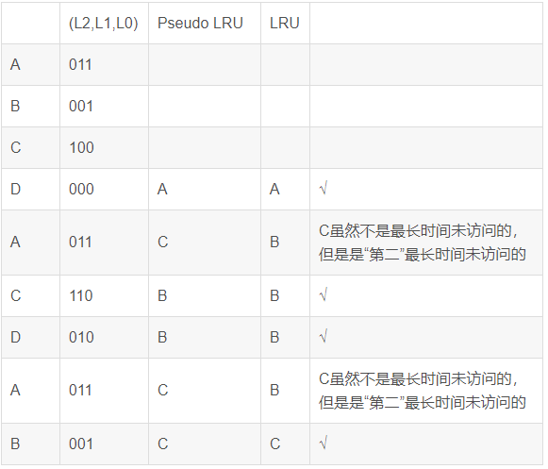
缓存替换策略
Pseudo LRU
访问序列 ABCDACDAB
Notes:
Being an undergraduate and to be an excellent graduate in computer science and technology, I think I have and should have the following qualities. The first one is solid theoretical foundation and good study ability, these can be shown via my transcript. Secondly, I have great scientific spirts. Pragmatic and innovation as the motto of Zhejiang University are deeply engraved in my heart. Done so many Courses’ projects make me work better with other people. Concentration
And self-discipline make me go farther on the road of scientific research. Last but not the least, the comprehensive quality of mine will be shown in my personal statement.

Slide 20
缓存替换策略
QLRU
在MRU策略中，每一个缓存行都有一个相应的状态位。每当访问一个缓存行时，它相应的状态位就会被置为0，如果某一次设置为0之后所有的缓存行状态位都是0，那么其他所有缓存行的状态位会被重新置为1。每当缓存未命中发生时，最左边一个状态位为1的缓存行将被替换。
一个使用了两个状态位的该策略的改进版则叫做QLRU（Quad-Age LRU），或者“2位重引用区间预测”（2-bit Re-reference Interval Prediction，RRIP）。两个状态位被设计来表示每一个块的年龄。
Notes:
Being an undergraduate and to be an excellent graduate in computer science and technology, I think I have and should have the following qualities. The first one is solid theoretical foundation and good study ability, these can be shown via my transcript. Secondly, I have great scientific spirts. Pragmatic and innovation as the motto of Zhejiang University are deeply engraved in my heart. Done so many Courses’ projects make me work better with other people. Concentration
And self-discipline make me go farther on the road of scientific research. Last but not the least, the comprehensive quality of mine will be shown in my personal statement.

Slide 21

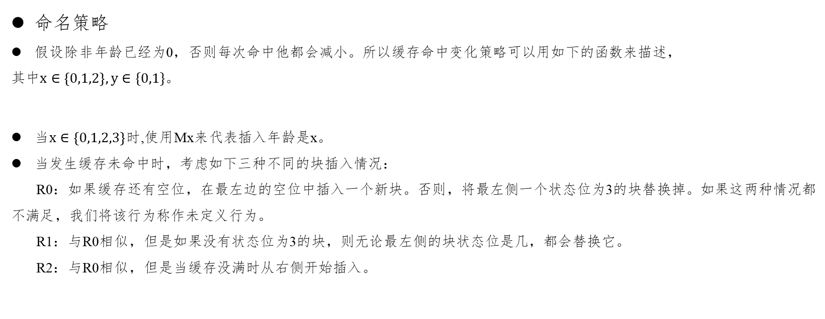
缓存替换策略
命名策略
假设除非年龄已经为0，否则每次命中他都会减小。所以缓存命中变化策略可以用如下的函数来描述，
其中$x∈\left\{0,1,2\right\}, y∈\{0,1\}$。
当$x∈\left\{0,1,2,3\right\}$时,使用Mx来代表插入年龄是x。
当发生缓存未命中时，考虑如下三种不同的块插入情况：
R0：如果缓存还有空位，在最左边的空位中插入一个新块。否则，将最左侧一个状态位为3的块替换掉。如果这两种情况都不满足，我们将该行为称作未定义行为。
R1：与R0相似，但是如果没有状态位为3的块，则无论最左侧的块状态位是几，都会替换它。
R2：与R0相似，但是当缓存没满时从右侧开始插入。
Notes:
Being an undergraduate and to be an excellent graduate in computer science and technology, I think I have and should have the following qualities. The first one is solid theoretical foundation and good study ability, these can be shown via my transcript. Secondly, I have great scientific spirts. Pragmatic and innovation as the motto of Zhejiang University are deeply engraved in my heart. Done so many Courses’ projects make me work better with other people. Concentration
And self-discipline make me go farther on the road of scientific research. Last but not the least, the comprehensive quality of mine will be shown in my personal statement.

Slide 22
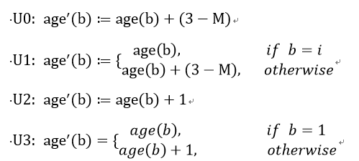
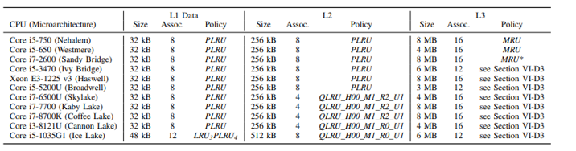
缓存替换策略
命名策略
如果在一次访问之后，没有任何一个块的年龄是3，那么所有块的状态位都有可能会被更新。让i代表被访问的块所在的位置，age(b)代表块b现在的年龄，age'(b)代表块b的新年龄（更新之后），M代表现在所有块中最大的年龄，我们考虑如下几种age'的变体：
Notes:
Being an undergraduate and to be an excellent graduate in computer science and technology, I think I have and should have the following qualities. The first one is solid theoretical foundation and good study ability, these can be shown via my transcript. Secondly, I have great scientific spirts. Pragmatic and innovation as the motto of Zhejiang University are deeply engraved in my heart. Done so many Courses’ projects make me work better with other people. Concentration
And self-discipline make me go farther on the road of scientific research. Last but not the least, the comprehensive quality of mine will be shown in my personal statement.

Slide 23
缓存替换策略
适应性策略：一些缓存使用了适应性替换策略，这种策略可以动态地在两种不同的替换策略中进行选择。这可以通过组竞争（set dueling）来应用。组竞争指的是每个策略都有许多组专门使用，其余的组是追随者组（follow sets），追随者组使用当前性能更好的策略。
Haswell，Broadwell架构的CPU仅仅让C-Box 0中存在固定策略组，其他所有的组都是追随者组。
两者都在512-575组中使用了QLRU_H11_M0_R0_U0策略，在768-831组中使用的策略与QLRU_H11_MR_16 1_R1_U2相似。
英特尔微架构从Sandy Bridge架构开始，最底层一级缓存就被分成多个片，每个片都按照上面描述的方式进行组织。这些片由所谓的C-Box管理，C-Box提供了核心和最底层一级缓存之间的接口，并负责维护缓存的一致性。通常，每个物理核心有一个C-Box。第一个使用L3级缓存片的微架构(Sandy Bridge, Ivy Bridge, Haswell)的每个C-Box有一个片[34,35,36,37,38,39,40]，Skylake和最近的微架构可以在每个C-Box上有多个片[41,42]，每个C-Box都有几个性能计数器，它们可以用来做诸如计算最底层一级缓存相应部分的查找事件的数量等事情。
Notes:
Being an undergraduate and to be an excellent graduate in computer science and technology, I think I have and should have the following qualities. The first one is solid theoretical foundation and good study ability, these can be shown via my transcript. Secondly, I have great scientific spirts. Pragmatic and innovation as the motto of Zhejiang University are deeply engraved in my heart. Done so many Courses’ projects make me work better with other people. Concentration
And self-discipline make me go farther on the road of scientific research. Last but not the least, the comprehensive quality of mine will be shown in my personal statement.

Slide 24
Thanks for Listening
徐天宇 浙江大学
^{10th} June 2021
nanoBench: A Low-Overhead Tool for Running
Microbenchmarks on x86 Systems
浙江大学Arclab实验室周会

